Slide 1
Battle of Neighborhood
Capstone Project
Chandra Sekhar R Matta

Slide 2
Problem Statement
There is a wholesale shop owner in one of the neighborhoods of Toronto.
This retail shop provides supplies to different other businesses such as Restaurants, Bakery, Breakfast Spot, Brewery and Café with fresh and high-quality supplies.
The wholesale shop wants to build a warehouse for the supplies it buys from its vendors and farmers, so that they will support more customers.

Slide 3
Data Requirements
To do this project, we need geo-locational information about that specific borough and the neighborhoods in that borough.
We assume it is "Scarborough" in Toronto. This is easily provided for us by the Wholesale Shop owner.
Data is required about different venues in different neighborhoods of that specific borough.
In order to gain that information we will use "Foursquare" locational information. A typical request from Foursquare will provide us with the following information:

Slide 4
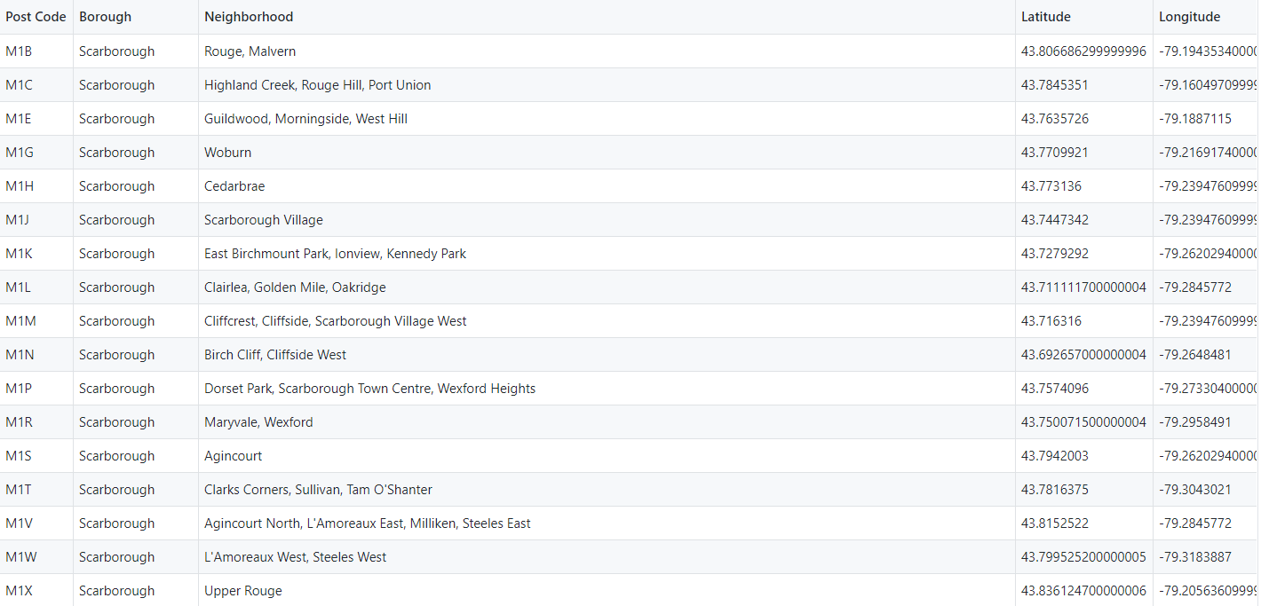
Data Requirements

Slide 5
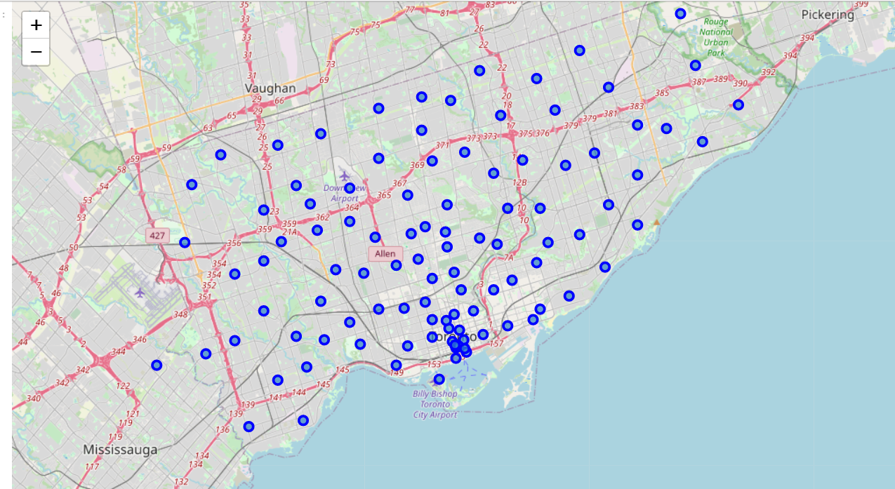
Identifying postal codes around Scarborugh

Slide 6
Reporting Results
Now, we focus on the centers of clusters and compare them for their "Total Restaurants" and their "Total Joints".
The group which its center has the highest "Total Sum" will be our best recommendation to the contractor.
{Note: Total Sum = Total Restaurants + Total Joints.} This algorithm although is pretty straightforward yet is strongly powerful.

Slide 7
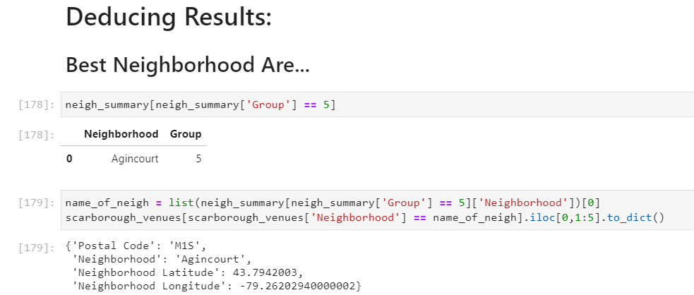
Reporting Results

Slide 8
Thank You

